Slide 1
Using A Geospatial API to Scout for Optimal Restaurant Locations
Bryce Goodsite

Slide 2
Location, Location, Location
Picking the correct location for a business, especially restaurants, can be the deciding factor in the success of the business.
Even more important for smaller business, like family owned establishments since they lack the large financial cushioning of wealthy chains.
We will use the Foursquare API to identify possible trends qualitatively that may signify prospective areas for the second locations of a family-run restaurant.

Slide 3
Data Acquisition and Cleaning
The data for the neighborhoods of Atlanta was pulled from a list of the neighborhoods on a Wikipedia page.
The table contained 161 neighborhoods and their respective populations, but lacked coordinates that would be usable for Foursquare data.
The Nominatim function from the geopy library was used to convert the address name into geographic coordinates.
Neighborhoods that were not able to be located with the function were then cut from the data frame.

Slide 4
Trimming the available geospatial data
The decision was made to focus the search of locations to North of Downtown, and within a certain corridor off of the major North-South highway.
Another requirement was exposure to local residents, and having a certain population in a neighborhood was added as a requirement. Neighborhoods with less than 1200 people were cut from the list, yielding 33 locations.

Slide 5
The Starbucks effect
The “Starbucks Effect” is the phenomena of how a Starbucks store opening increases home and property values.
Between 1997 and 2014, properties closer to the coffee shop increased in value by 96%, compared to 65% for all U.S. residential properties.
The locations of Starbucks can be used as a proverbial “canary in the coal mine” for an up-and-coming area.
This information was then used to identify areas that may be particularly affluent.
This holds true for residential neighborhoods, but not as much for places of business (such as being located in the finance district), a target (which Starbucks has a deal with), or other locations such as college campuses, malls, or anything else that is not reflective of an area that is residential.

Slide 6
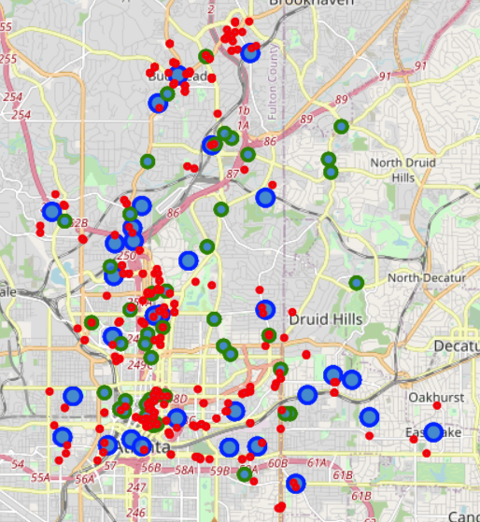
Map of Atlanta
Below is a map of Atlanta with neighborhoods in blue, Starbucks in green, and other coffee shops in red.
Other cafes were added because they tend to cluster in areas with enough discretionary (luxury) spending to be able to sustain their operations and remain in business.

Slide 7
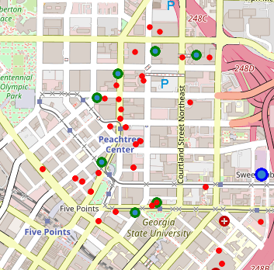
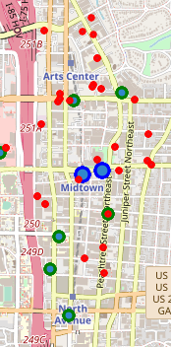
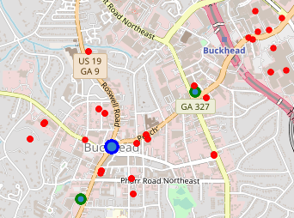
Results
After mapping all of the locations onto a Folium map with the aid of the Foursquare API, it was seen that several areas would be good candidates.
Based off of these findings, the second restaurant should be located in Downtown, Midtown, or Buckhead.
Neighborhood locations (blue), the Starbucks locations (green), and the independently owned cafes (red).
Downtown
Midtown
Buckhead

Slide 8
Future Discussions
Identify better economic indicators such as average home value, average household income, cost of leases for restaurants, crime rates, etc.
Identify similar restaurants by the ratings.
Identify the best mix of ratings of restaurants and the cost of doing business in an area.
There are certain tools out there for this, however they typically cost money and would require an additional learning curve to utilize effectively.

